Slide 1
ILSMC: a phylogenetically aware SMC to infer the evolutionary history of species
Iker Rivas-González

Slide 2
Overview
CoalHMM
SMCs
ILSMC
Discussion

Slide 3
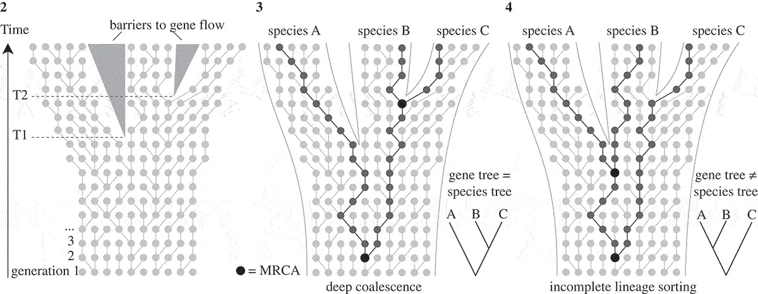
CoalHMM
Leliaert et al. (2013)

Slide 4
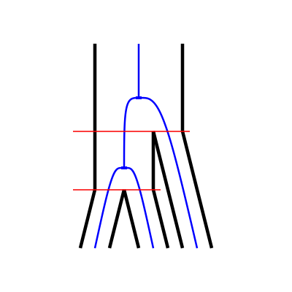
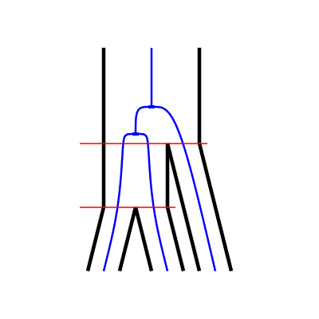
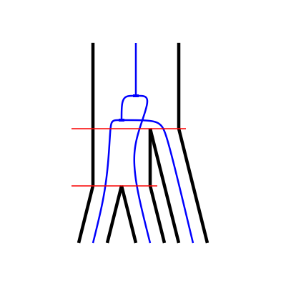
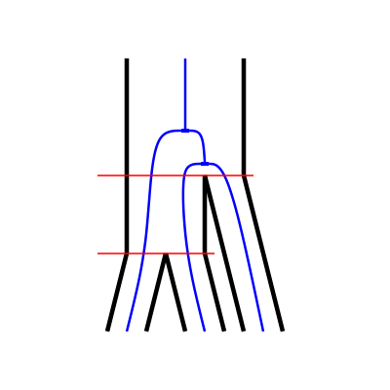
CoalHMM
V0
V1
V2
V3

Slide 5
CoalHMM
V0
V1
V2
V3
Split times.
Ancestral population sizes.
Mutation rate.
Recombination rate.
Parameterized by

Slide 6
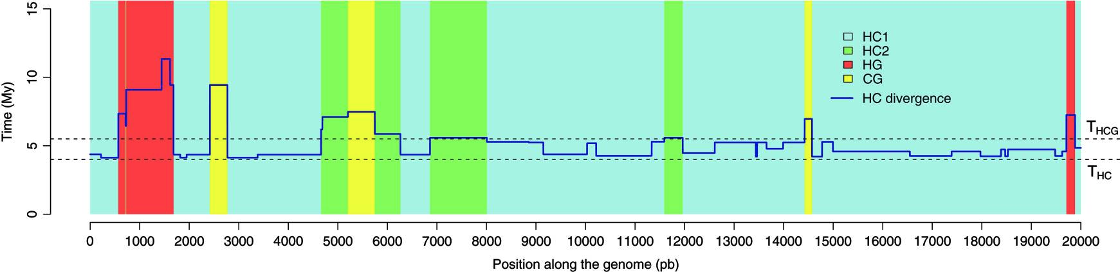
CoalHMM
Dutheil et al. (2009)

Slide 7
CoalHMM
V0
V1
V2
V3
Problem: parameter estimates are biased

Slide 8
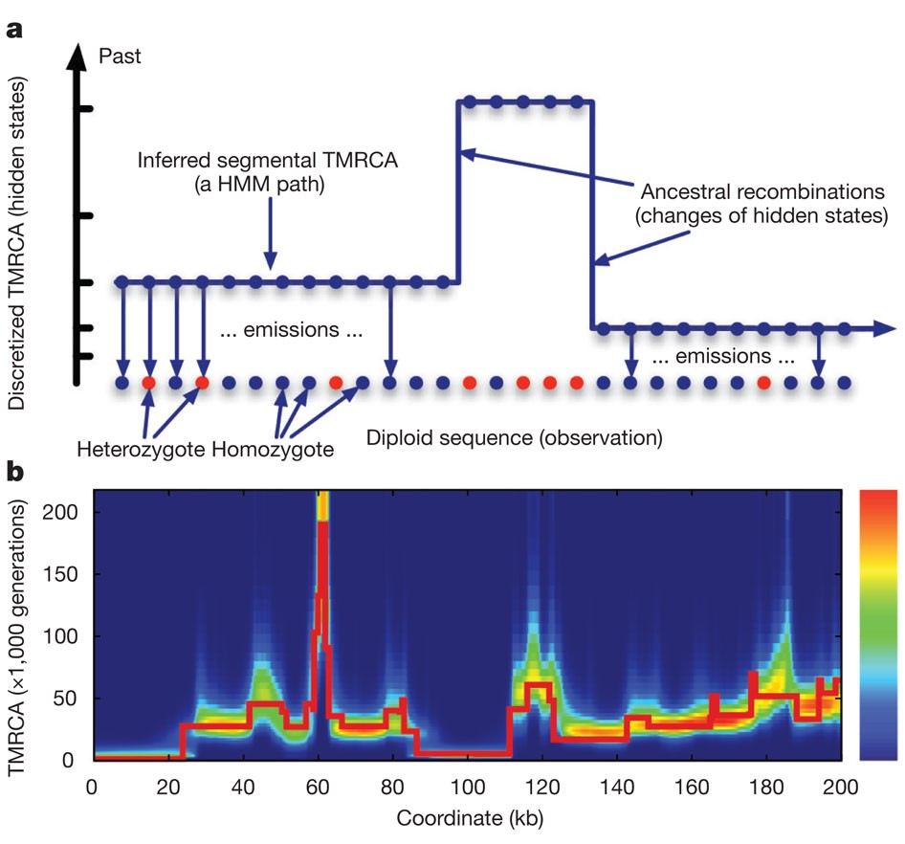
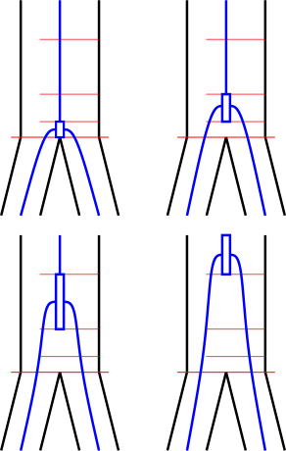
SMCs
Li and Durbin (2011)

Slide 9
SMCs
Parameterized by:
Ancestral population sizes.
Mutation rate.
Recombination rate.
Li and Durbin (2011)

Slide 10
SMCs
Parameterized by:
Ancestral population sizes.
Mutation rate.
Recombination rate.
Problems:
Only one coalescent event is modeled
Li and Durbin (2011)

Slide 11
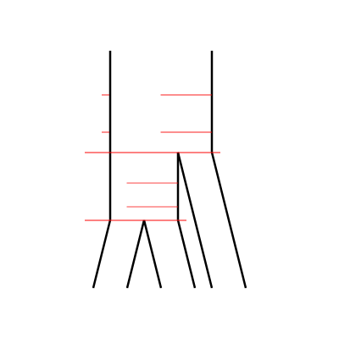
ILSMC
ILSMC:
Extract the ILS information CoalHMM-style
Parameterize SMC-style.

Slide 12
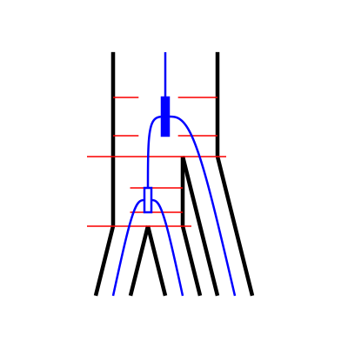
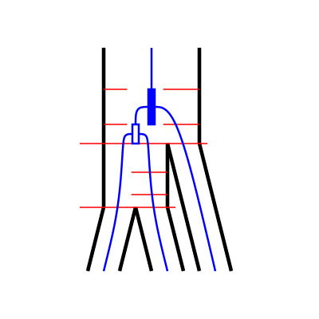
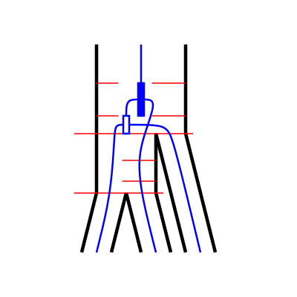
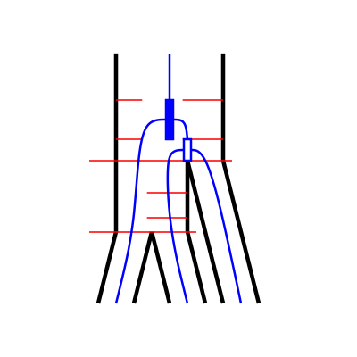
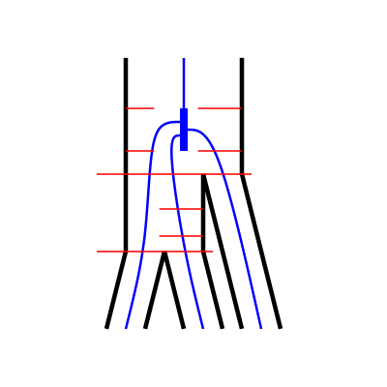
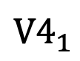
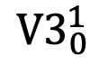
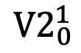
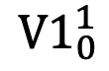
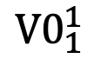
ILSMC
$${V0}_{1}^{1}$$
$${V1}_{0}^{1}$$
$${V2}_{0}^{1}$$
$${V3}_{0}^{1}$$
$${V4}_{1}^{ }$$

Slide 13
ILSMC
$${V0}_{1}^{1}$$
$${V1}_{0}^{1}$$
$${V2}_{0}^{1}$$
$${V3}_{0}^{1}$$
$${V4}_{1}^{ }$$
Parameterized by:
Split times.
Ancestral effective population sizes.
Number of intervals for discretization.
Recombination rate.
Mutation rate.

Slide 14
ILSMC
Three-sequence CTMC
Two-sequence CTMC
One-sequence CTMC
One-sequence CTMC
One-sequence CTMC

Slide 15
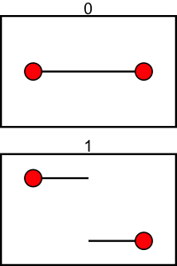
ILSMC
1C
1R
One-sequence CTMC
One-sequence CTMC
One-sequence CTMC

Slide 16
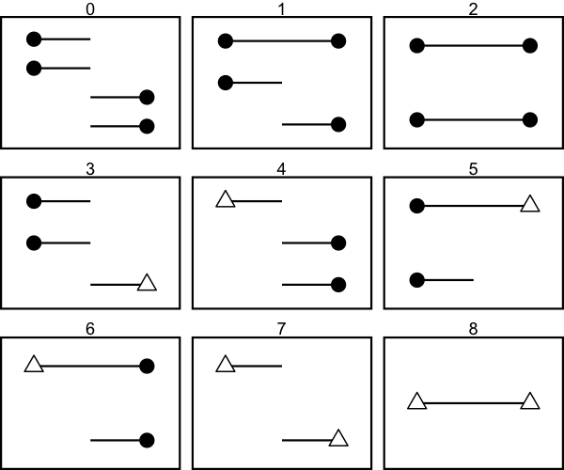
ILSMC
Two-sequence CTMC

Slide 17
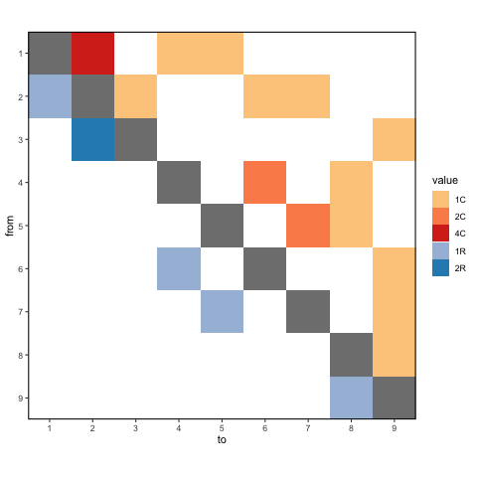
ILSMC
Two-sequence CTMC

Slide 18
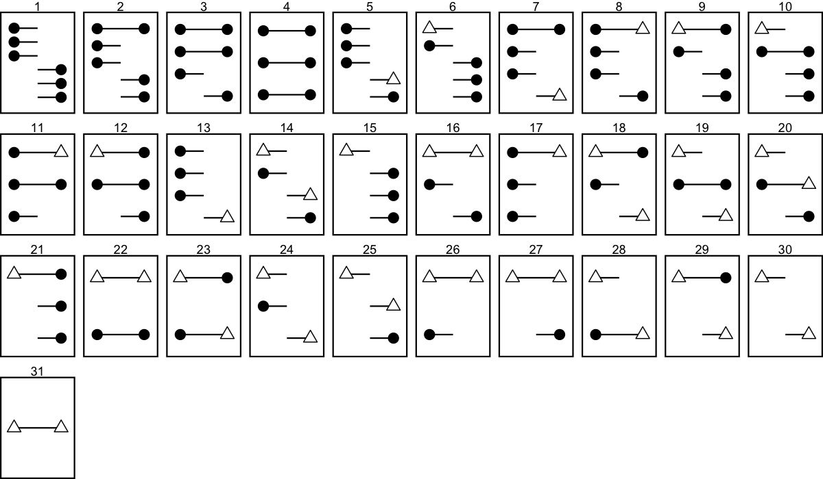
ILSMC
Three-sequence CTMC

Slide 19
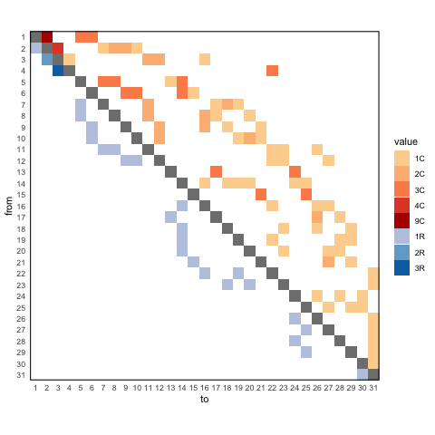
ILSMC
Three-sequence CTMC

Slide 20
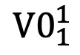
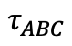
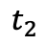
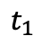
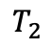
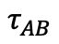
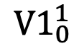
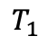
ILSMC
Left site
Right site
$${V0}_{1}^{1}$$
$${V1}_{0}^{1}$$
$$T_{2}$$
$$T_{1}$$
$$τ_{ABC}$$
$$t_{2}$$
$$t_{1}$$
$$τ_{AB}$$

Slide 21
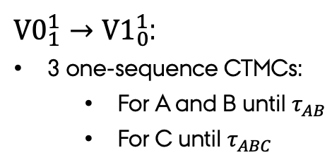
ILSMC
Left site
Right site
${V0}_{1}^{1}→{V1}_{0}^{1}$:
3 one-sequence CTMCs:
For A and B until $τ_{AB}$
For C until $τ_{ABC}$
$${V0}_{1}^{1}$$
$${V1}_{0}^{1}$$
$$T_{2}$$
$$T_{1}$$
$$τ_{ABC}$$
$$t_{2}$$
$$t_{1}$$
$$τ_{AB}$$

Slide 22
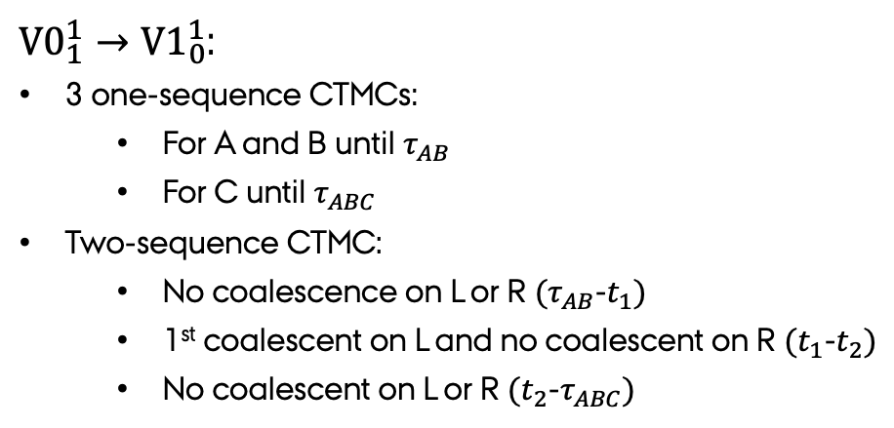
ILSMC
Left site
Right site
${V0}_{1}^{1}→{V1}_{0}^{1}$:
3 one-sequence CTMCs:
For A and B until $τ_{AB}$
For C until $τ_{ABC}$
Two-sequence CTMC:
No coalescence on L or R $(τ_{AB}$-$t_{1})$
1st coalescent on L and no coalescent on R $(t_{1}$-$t_{2})$
No coalescent on L or R $(t_{2}$-$τ_{ABC})$
$${V0}_{1}^{1}$$
$${V1}_{0}^{1}$$
$$T_{2}$$
$$T_{1}$$
$$τ_{ABC}$$
$$t_{2}$$
$$t_{1}$$
$$τ_{AB}$$

Slide 23
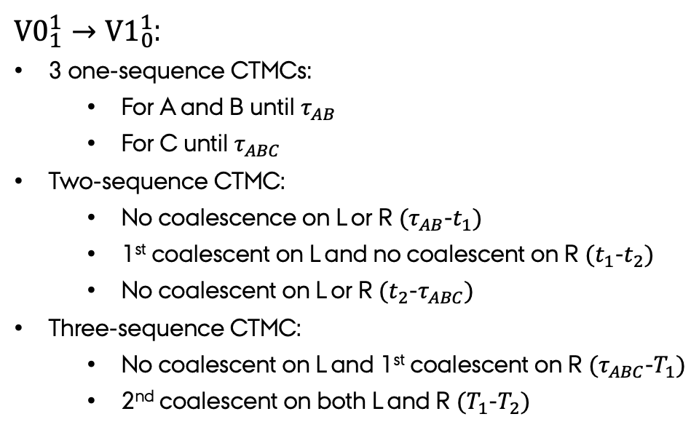
ILSMC
Left site
Right site
${V0}_{1}^{1}→{V1}_{0}^{1}$:
3 one-sequence CTMCs:
For A and B until $τ_{AB}$
For C until $τ_{ABC}$
Two-sequence CTMC:
No coalescence on L or R $(τ_{AB}$-$t_{1})$
1st coalescent on L and no coalescent on R $(t_{1}$-$t_{2})$
No coalescent on L or R $(t_{2}$-$τ_{ABC})$
Three-sequence CTMC:
No coalescent on L and 1st coalescent on R $(τ_{ABC}$-$T_{1})$
2nd coalescent on both L and R $(T_{1}$-$T_{2})$
$${V0}_{1}^{1}$$
$${V1}_{0}^{1}$$
$$T_{2}$$
$$T_{1}$$
$$τ_{ABC}$$
$$t_{2}$$
$$t_{1}$$
$$τ_{AB}$$

Slide 24
Discussion
Current state:
One- and two-sequence CTMCs working.
Three-sequence CTMC coded but not working.

Slide 25
Discussion
Current state:
One- and two-sequence CTMCs working.
Three-sequence CTMC coded but not working.
Future work:
Emission probabilities.
Chose and code optimization procedure.
Analyze simulated data.

Slide 26
Discussion
Current state:
One- and two-sequence CTMCs working.
Three-sequence CTMC coded but not working.
Future work:
Emission probabilities.
Chose and code optimization procedure.
Analyze simulated data.
Future perspective:
ILSMC is flexible:
Different parameterization per interval
ILSMC is extensible:
ILS and introgression.

